Slide 1

Software Design and architecture (SE322) gg
Week 12
Said Nabi
said.nabi@giki.edu.pk
Faculty of Computer Science and engineering
Gik Institute Topi, Swabi

Slide 2
List of Topics
UML Architectural Diagrams (Component, Package, Deployment, Activity Diagrams, Architecture Styles)

Slide 3
UML Component Diagram
Components are the independent, encapsulated units within a system.
Each component provides an interface for other components to interact with it. Component diagrams are used to visualize how a system’s pieces interact and what relationships they have among them.
Component diagrams focus solely on depicting high-level system components and their interactions, rather than detailed elements like attributes or methods
Component diagrams give a static snapshot of a system by showing its components, their interfaces, and their relationships.
Component diagrams use ball connectors to show interfaces a component provides and socket connectors to show interfaces it requires from other components.

Slide 4
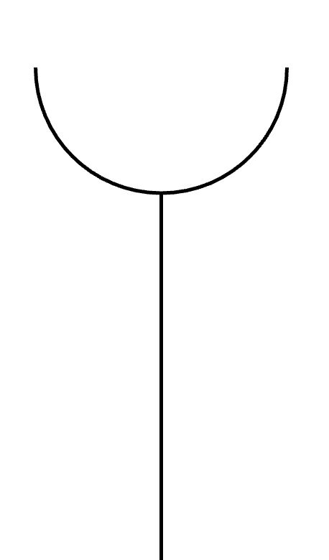
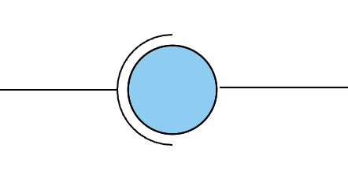
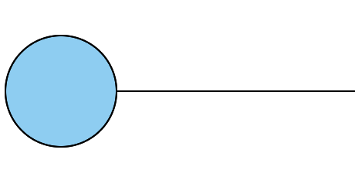
UML Component Diagram Cont…
Component diagrams show assembly relationships where one component’s provided (ball) interface matches another’s required (socket) interface.
Socket
Interface
assembly

Slide 5
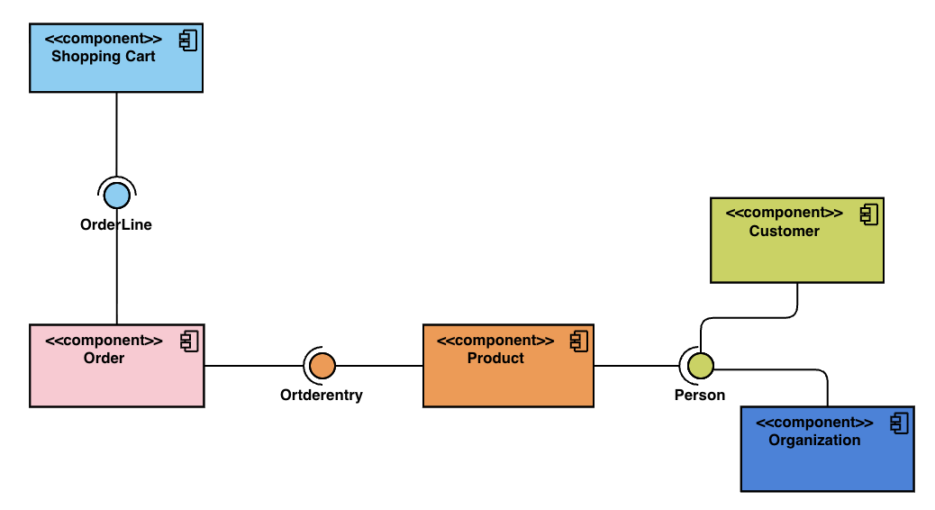
UML Component Diagram Cont…
To build a component diagram, first, you must identify the main components used in the system. Next, the relevant libraries for the system need to be identified.
Finally, the relationship between these components would need to be identified.

Slide 6
Package Diagram
A package groups related software elements—such as data, classes, or tasks—into one unit. It can also act as a named namespace, giving its contents their own scope.
Elements inside a package can be uniquely identified by their fully qualified names, which combine the element’s name with the package name.
Package diagrams show packages and the dependencies between them.
They organize a system into high-level groups of related elements—such as data, classes, or other packages—making it easier to see what each package contains and how packages depend on one another.

Slide 7
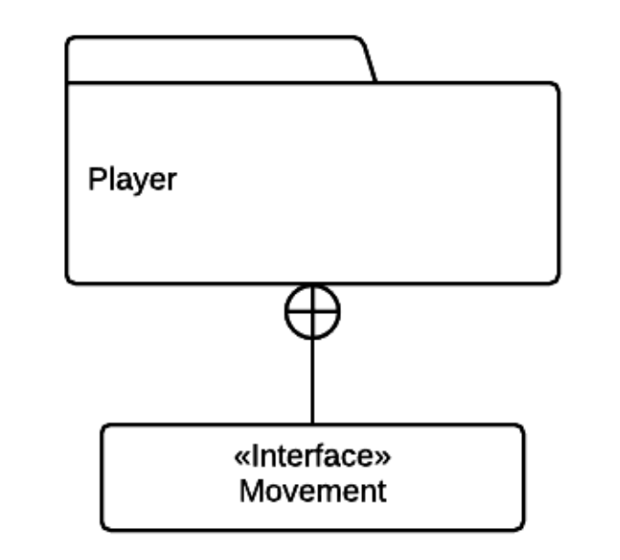
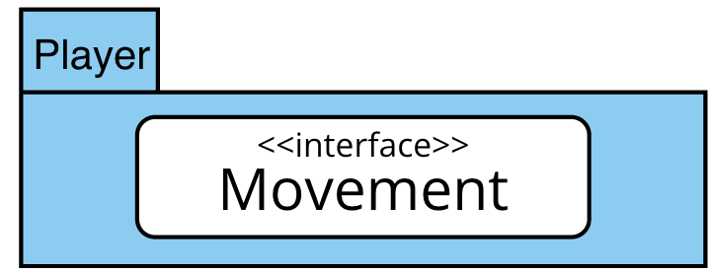
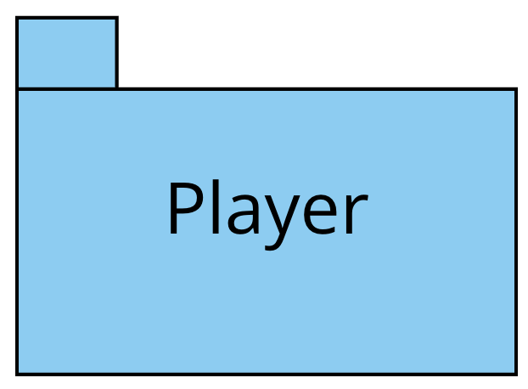
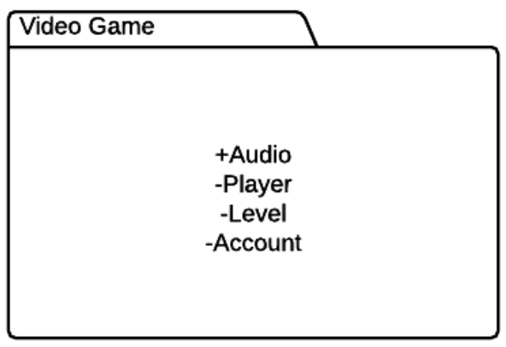
Package Diagram Cont…
Packages are shown as tabbed folder icons. If the package has no visible contents, its name appears in the center.
When details are included, elements can be displayed inside the folder to show what the package contains.
A package can include elements shown outside the folder to indicate composition or listed inside by unique names.
Plus (+) and minus (–) signs show public and private elements. Public elements can be accessed using their fully qualified names, and relationships are shown with dotted arrows.

Slide 8
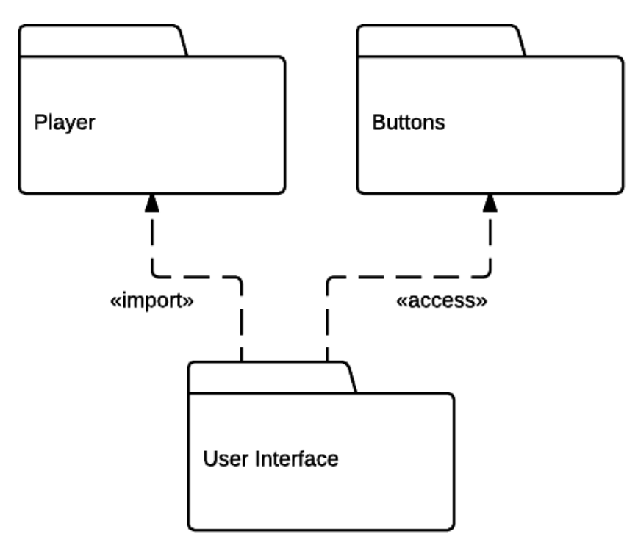
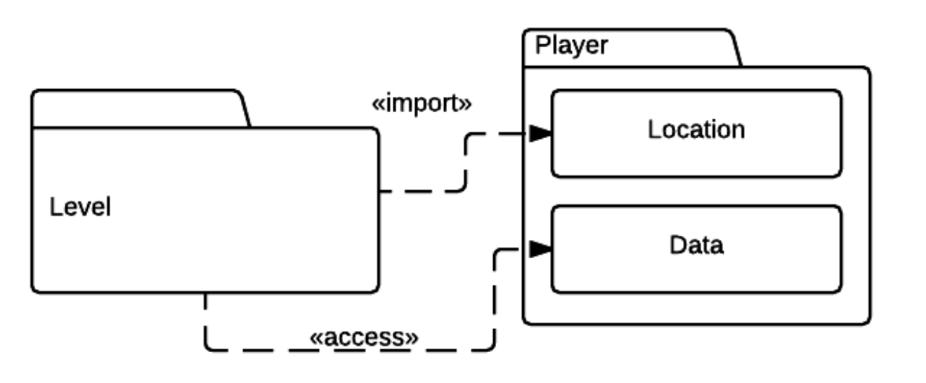
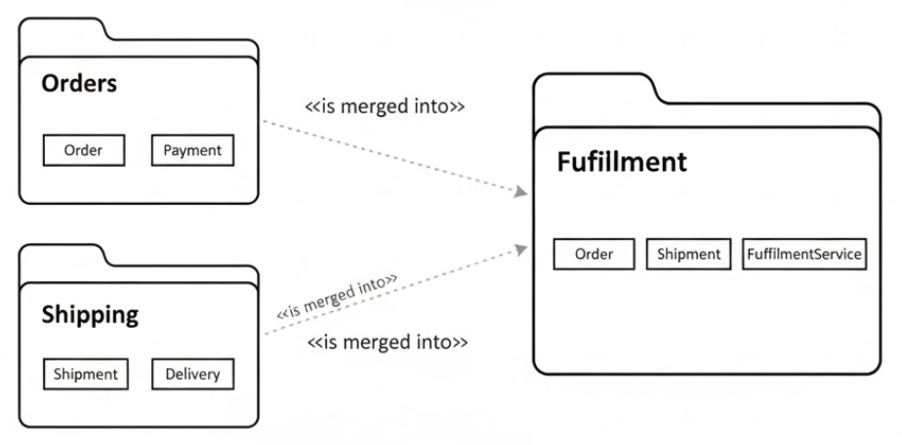
Package Diagram Cont…
A package can import elements from another package, bringing the imported name into its own namespace for easier use.
If the import is public, the name can be re-exported for others to import.
If the import is private, the name is only visible within that package and not outside it.
A package can import all contents of other packages. Public imports make the names visible for further use outside the package, while private imports limit visibility to within the importing package’s namespace.
Packages can be merged when two packages or concepts need to combine, using generalization to allow different definitions for the same concept.

Slide 9
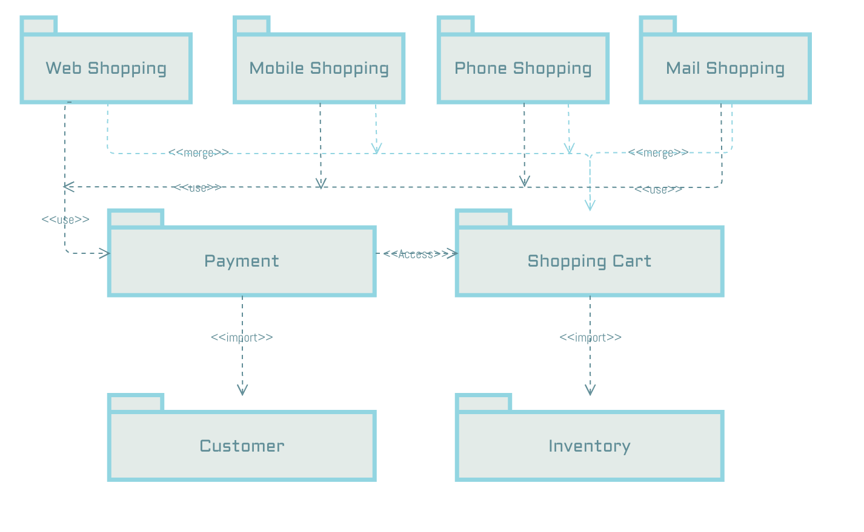
Package Diagram Example

Slide 10
Deployment Diagram
UML deployment diagrams show how a software system is deployed, including code, libraries, installers, configuration files, and other components, along with the environments where they run.
The deployment environment can be specific (particular hardware) or general (supported operating systems), and deployment diagrams reflect these details, showing differences for platforms like Linux, MacOS, or Windows.
Deployment diagrams focus on artifacts, the physical outputs of development, such as executables, installers, libraries, and assets, which are the final pieces needed to deploy the system.
There are two types of deployment diagrams: specification-level diagrams and instance-level diagrams.

Slide 11
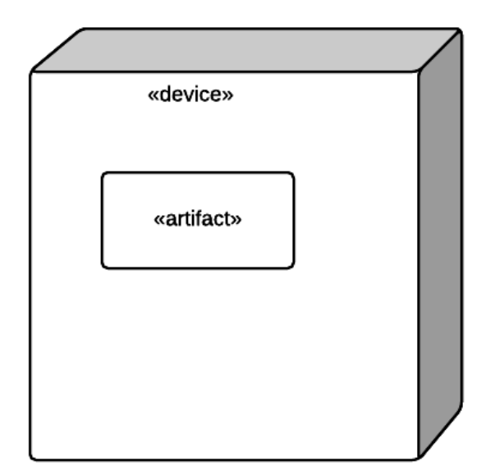
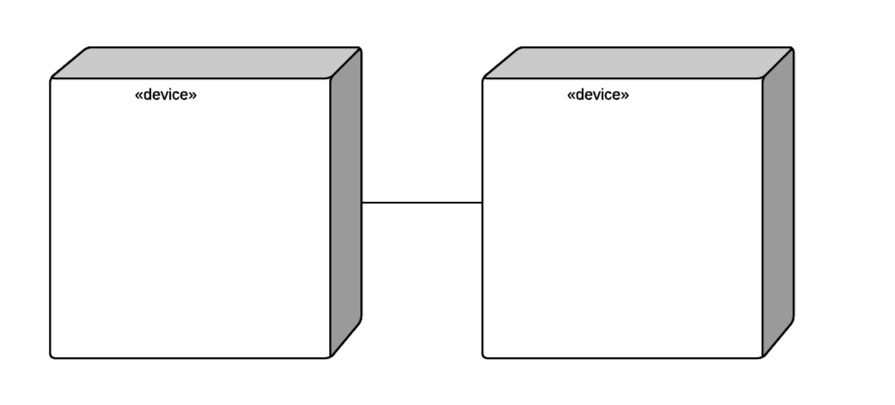
Deployment Diagram Cont..
A specification-level diagram shows an overview of artifacts and deployment targets without specifying details like machine names, focusing on a general deployment view.
An instance-level diagram maps specific artifacts to specific deployment targets, including machines and hardware, and highlights differences between development, staging, and release deployments.
In deployment diagrams, nodes represent deployment targets containing executable artifacts and are shown as 3D boxes.
Hardware devices are also 3D boxes but tagged as “device.” Relationships between nodes are shown with solid lines, indicating communication paths and the protocols used.

Slide 12
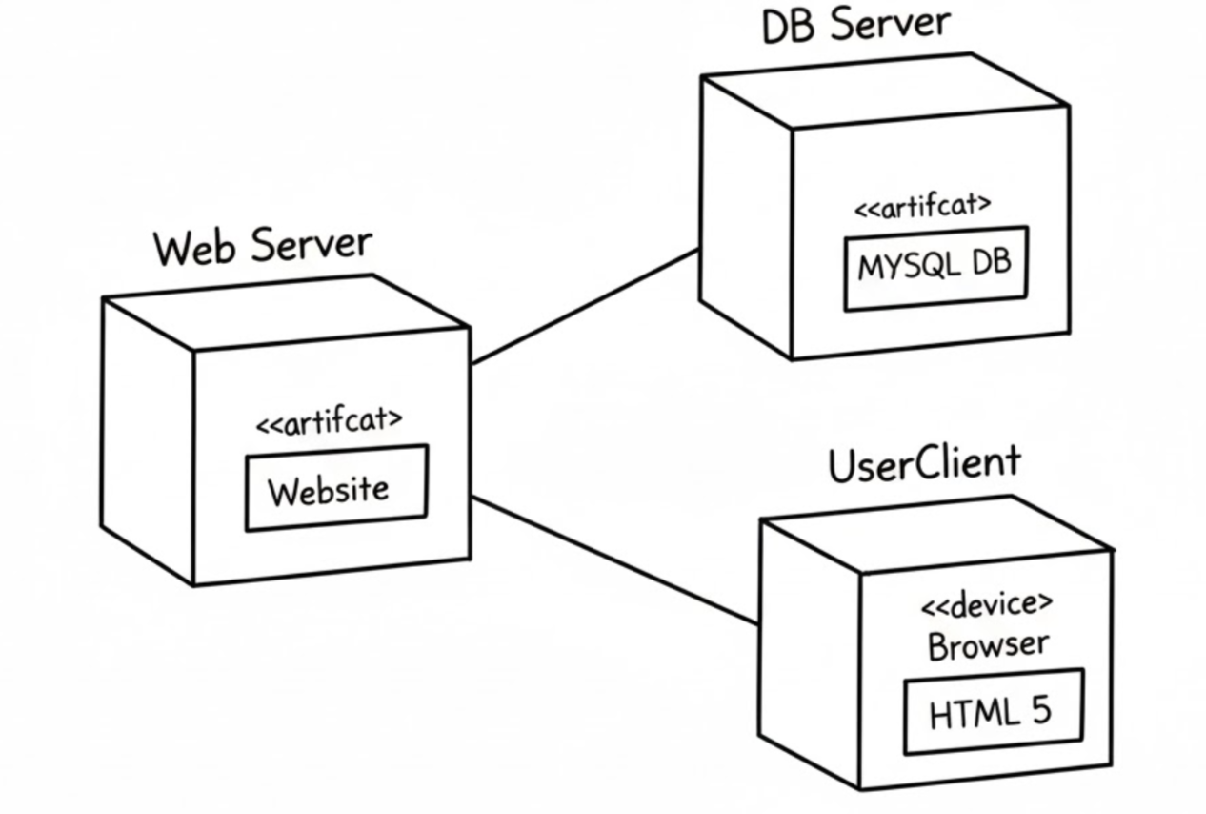
Deployment Diagram Cont..
Deployment diagrams show a hierarchy of deployment targets, from application to device, operating system, and execution environment.
They include only the most important artifacts to provide a high-level overview, ensuring consistency, organization, and clarity about the files and components needed to deploy and run the software.
Diagrams can be instance-specific or general across environments.

Slide 13
Activity Diagram
A UML activity diagram represents the control flow between activities, capturing the system’s dynamic behavior and branching into alternative flows.
Activities are actions that advance the system’s execution, often creating or altering objects. To create an activity diagram, first identify the activities and their conditions, then represent them along with the main diagram elements.
Activity diagrams start with a start node (labeled circle) and end with an end node. Intermediate activities are shown as ovals representing actions that change the system state. Decision nodes (diamonds) show branching with two or more alternative outcomes based on conditions.
An activity diagram should include all essential activities and their conditions. For example, it can illustrate the flow of a video game.

Slide 14
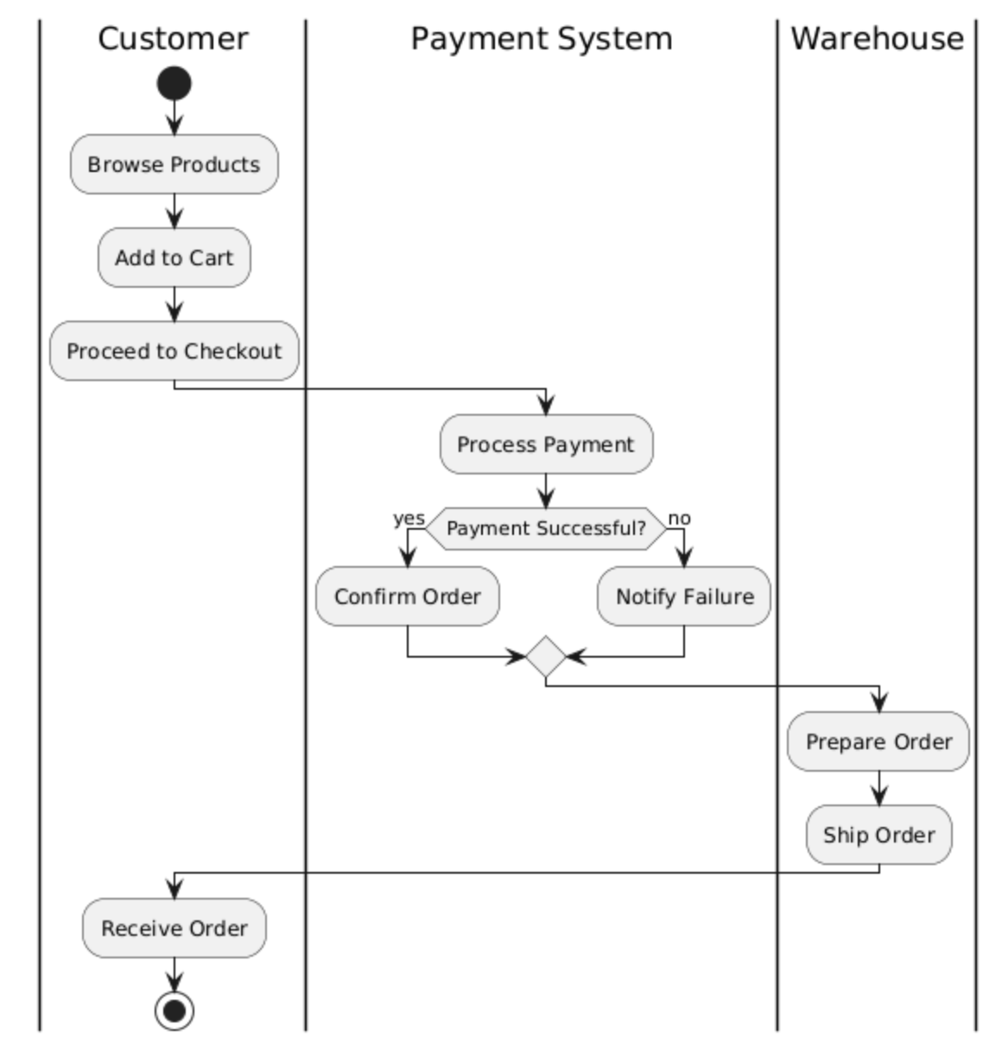
Activity Diagram Example
The activity diagram starts when a customer begins shopping. Activities include Browsing Products, Adding to Cart, Checkout, Payment, and Order Confirmation.
Decision nodes handle conditions failed payment.
Swimlanes show roles (Customer, Payment System, Warehouse), with arrows indicating interactions.
The diagram visualizes the sequence of activities, alternative flows, and role-based responsibilities in an online store.
https://www.cybermedian.com/tutorial-on-uml-swimlane-activity-diagrams/

Slide 15
Architecture Styles
Architecture styles can be grouped into two categories: monolithic, where all code is deployed as a single unit, and distributed, where code is split into multiple components communicating over remote protocols.
Architecture styles are standard, named ways of structuring software systems.
Each name acts as shorthand, helping architects communicate complex ideas quickly.
When someone mentions a style (like “layered monolith”), others already know the typical structure, qualities, deployment, and trade-offs.
Because of this, architects must learn the basic names of these fundamental architecture styles.
Each style name carries a lot of pre-understood information, similar to design patterns.
An architecture style also describes the topology (how parts connect) and the default characteristics—both the helpful ones and the limiting ones.
While modern systems may use many new patterns, architects still need to understand the core foundational patterns that are often used inside larger, more complex architectures.

Slide 16
What’s the difference between Architecture style and Architecture pattern?

Slide 17
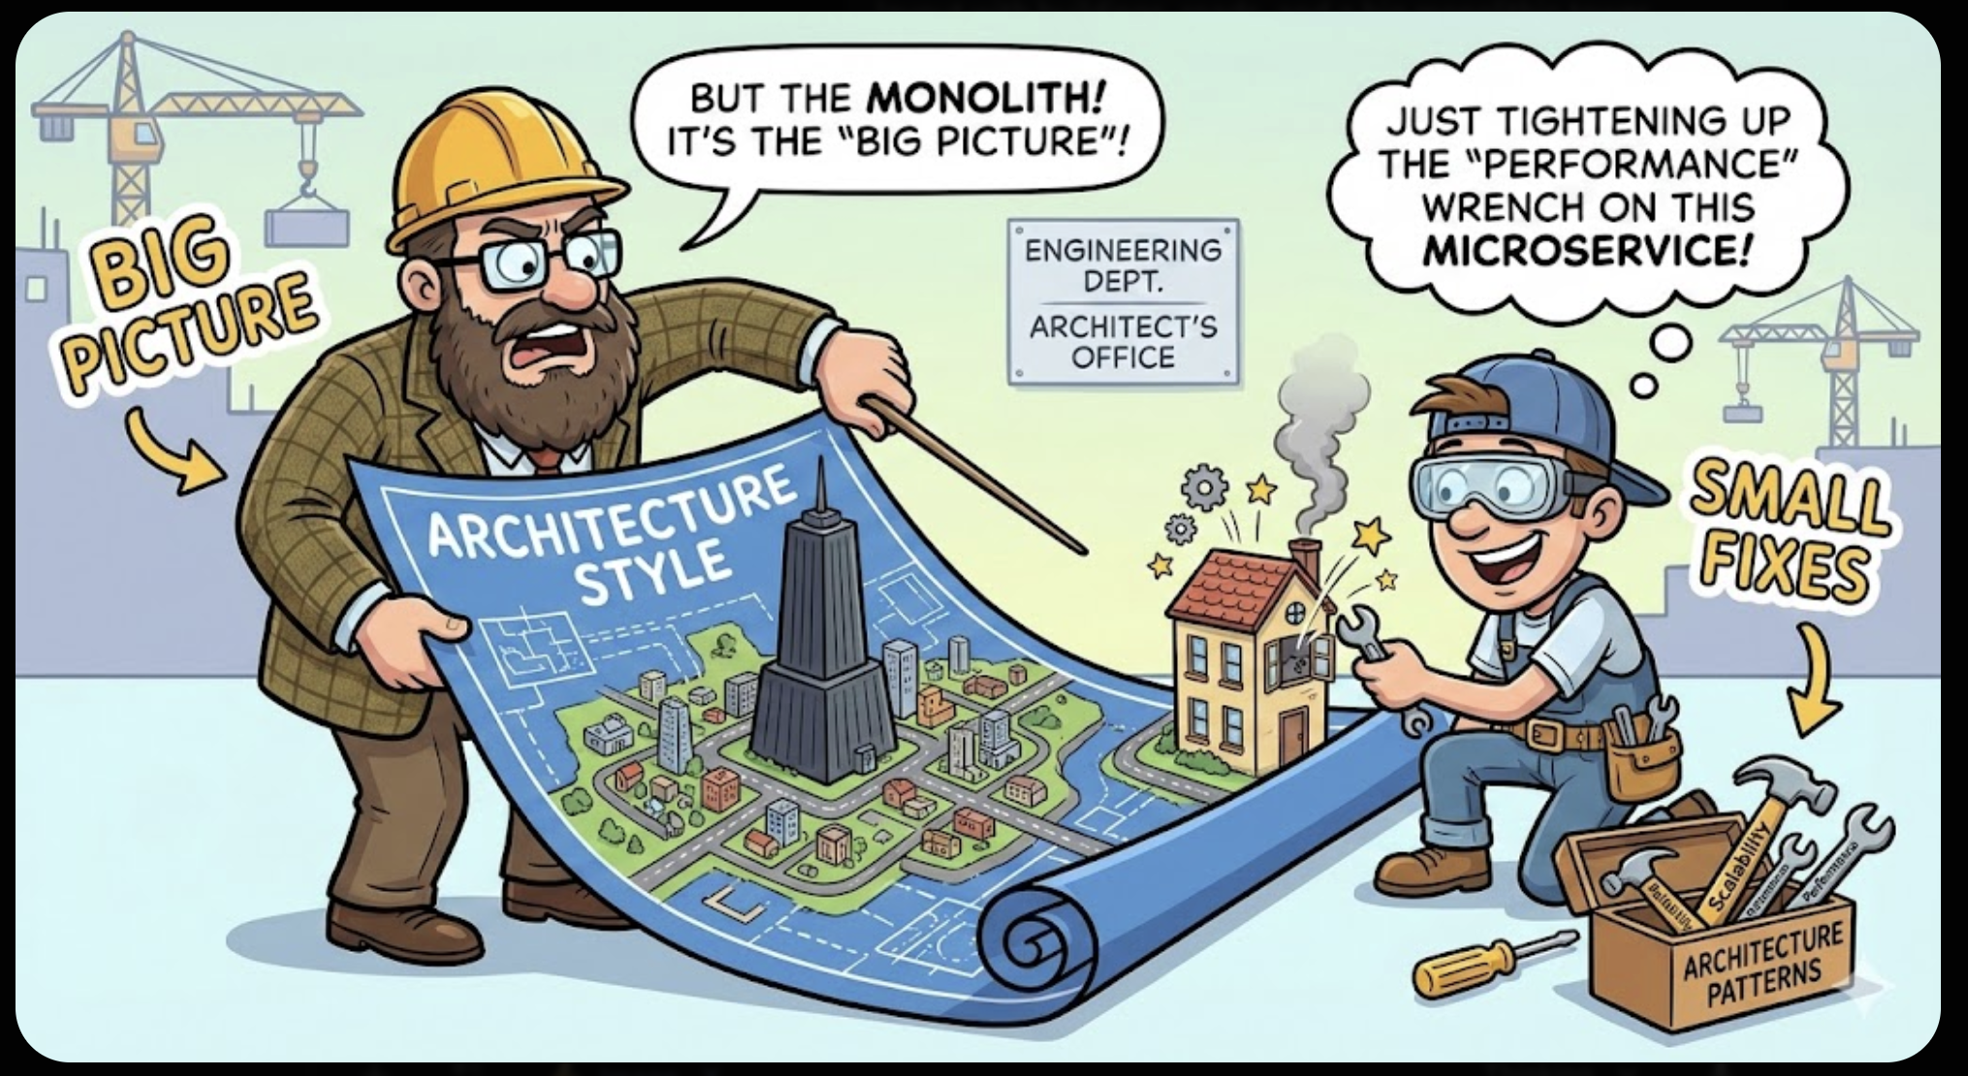

Slide 18
Architecture Styles vs Architecture pattern
The difference between an architecture style and an architecture pattern can be confusing.
An architecture style describes the overall structure of a system — how the user interface, backend code, and database are arranged and connected.
Examples include having everything in layers inside a monolith or using separately deployed services.
An architecture pattern, however, is a smaller, lower-level design solution used inside an architecture style.
Patterns help solve specific problems, such as achieving high scalability, high performance, or improving communication between services.
New architects spend a lot of time learning architecture styles because they are important and widely used.
Each style has its own trade-offs, and understanding these helps architects choose the right style for a particular business problem.

Slide 19


Slide 20
Layered Monolithic Architecture
The Layered Monolithic Architecture organizes an application into separate horizontal layers, each with a clear responsibility—typically presentation, business logic, and data access.
All layers are packaged and deployed together as a single unit, making development and deployment simple.
Communication generally flows top-down, with each layer interacting only with the layer directly beneath it.
This style is easy to understand, supports good separation of concerns, and works well for traditional business applications, but it can become rigid as systems grow because changes in one layer can ripple into others and make the architecture harder to evolve.
The Layered Monolithic Architecture offers ease of development, deployment, and testing, and promotes consistent organization, but it can be rigid, suffer performance overhead, be hard to scale, and risk tight coupling between layers.

Slide 21
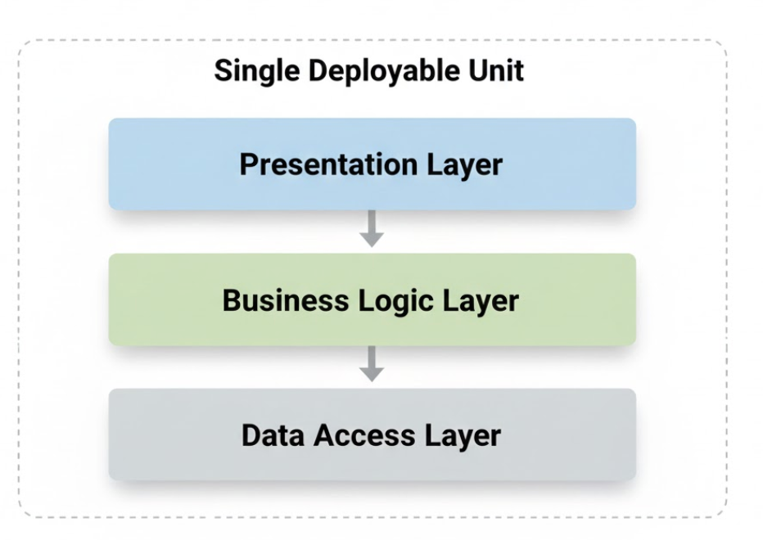

Slide 22
Thank You☺

